Slide 1

INNOVATION AND ENTREPRENEURSHIP: ENTREPRENEURSHIP THROUGH ACQUISITION (ETA)
Some Slides Courtesy of Brian Wolfe

Slide 2
WHAT IS ETA?
Rather than “greenfield” a new start-up, acquisition entrepreneurs “buy and build” an existing profitable small business, usually with the ultimate goal of selling for a profit
Can be “self-funded” (e.g., SBA 7(a) loan) or “traditional”(e.g., search fund funded)
“Micro PE”: Applies PE’s playbook (aim for double/predictability of outcome), but seeks to capture certain advantages:
Searcher can buy a small company w/ minimal equity check
Can stay out of auctions / source proprietary deal at favorable valuation
Better control timing of exit (v. PE fund life constraints)
Specialization/ability to focus on one vertical or single asset

Slide 3
ETA PURCHASE: WHAT’S TYPICAL
$1-7m in revenue and $500K-3m in EBITDA
History of profitability (perhaps, 10 years)
15% EBITDA margin (important to service debt and underwrite growth)
Steady growth industry
Loyal customers (ideally, recurring or reoccurring)
Purchase for $1-10m (altho SBA loans capped at $5M)
Can acquire in a “traditional” (e.g., search fund funded) search or via “self funded” search

Slide 4
PUTTING ETA INTO CONTEXT: CONTRASTING PRIVATE COMPANY INVESTMENT MODELS
Variables:
Passive or active investment?
Size of undertaking
Stage of growth
Private Equity
(control, predictable,
debt, $25M+,
closed ended fund)
Venture Capital
(minority, no
debt, closed ended, passive investment)
ETA
(you’re operator; can
own majority,
predictable, debt,
$2-10M deal size)
Start up
(control, limited
capital req’d to start,
need to get to sales/
PMF)
4

Slide 5
A (CYNICAL?) VIEW OF START-UPS V. ETA
Start-up | ETA
Need to establish product-market-fit (“PMF”) and get to revenue (getting from 0 to 1 is hard) | You acquire functioning biz model: you already have PMF and CF and can immediately seek to accelerate growth / optimize operations
Less capital intensive at launch | More capital intensive at start to acquire
High probability of failure: most startups fail and < 1% get to $10m of sales (but virtually unlimited upside if you succeed) | Higher probability of success (> 90%), but lower ceiling
Need to find co-founder(s) and/or build team | Company you acquire comes with team
Gov’t support via QSBS exclusion and SBA loans | Same
Cultural biases: sexy – I’m a “founder”; TechCrunch; YC; Bezos; Zuck; broad institutional support | You’re a small business owner – willing to own a pest control company?
Founder typically experiences significant equity dilution as company matures | Varies, but in some situation, can own up to all of the business you acquire
Think like an innovator | Think like an operator

Slide 6
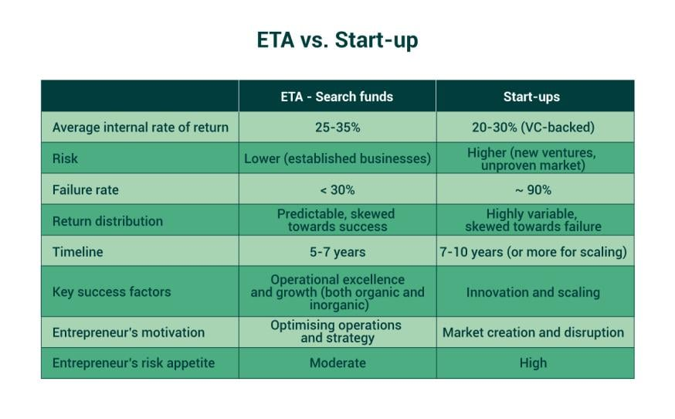
What Should You Choose?

Slide 7
SELF-FUNDED V. TRADITIONAL SEARCH
Self-funded Search | Traditional Search
Searcher responsible for 10% equity check and remainder of purchase price funded by SBA loan, w/ searcher providing PG | Searcher responsible for minimal equity capital; search fund provides equity capital and often no 3P debt (and no searcher PG)
Post-acquisition, searcher owns majority (up to 100%) of company that’s acquired | Searcher owns ~25% of acquired company which vests in 3 tranches (and search fund/LPs own rest)
Searcher needs to financially support himself/herself during search process | Searcher receives budget for salary and transaction expenses during up to 24 mo. search process (often, $425K)
Size of target generally capped at $5M by virtue of cap on SBA loan size | No cap on EV; target companies can be in range of $10 million
Searcher becomes owner-operator and controls own destiny; no investors to report to | Investors to report to, who may require liquidity event within specified time period, but search fund also provide operational support and lack of debt increases operational flexibility

Slide 8
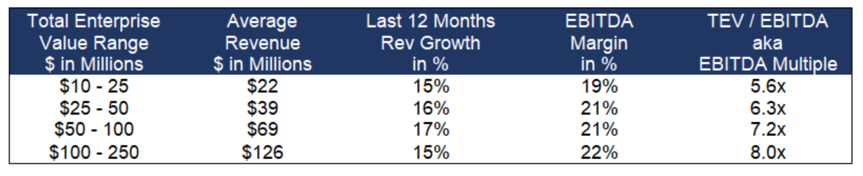
Deal Multiples/Valuation: Impact of Asset Size and Growth Rate
This data is from 2018 and although dated, the broad points are (a) small businesses can be acquired at relative
discounts (albeit with greater risk) and (b) acquiring a small business and growing that business can yield
meaningful multiple expansion at exit.
Prevalence of auctions for PE results in so-called “Winner’s Curse”
Note that EBITDA margin and organic growth are key variables to drive valuation growth

Slide 9
MAIN ACTORS IN ETA
Searcher: typically, 3-5 years of work experience and often an MBA; responsible for sourcing deal and operating the small business post-acquisition
Seller: often a solo owner-operator, but can be carve out/divestiture from larger operating company
Brokers: engaged by sellers to market the sale of a small business and help drive transaction process; increasingly, can also be engaged by buyers to accelerate search process
Investors and / lender
Advisors: lawyers; accountants

Slide 10
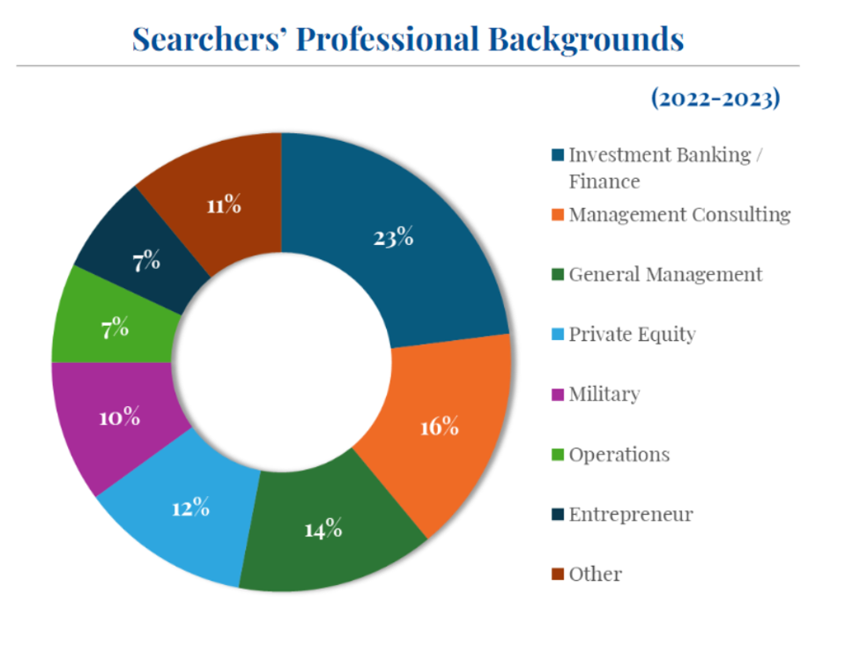
Characteristics of Searchers

Slide 11
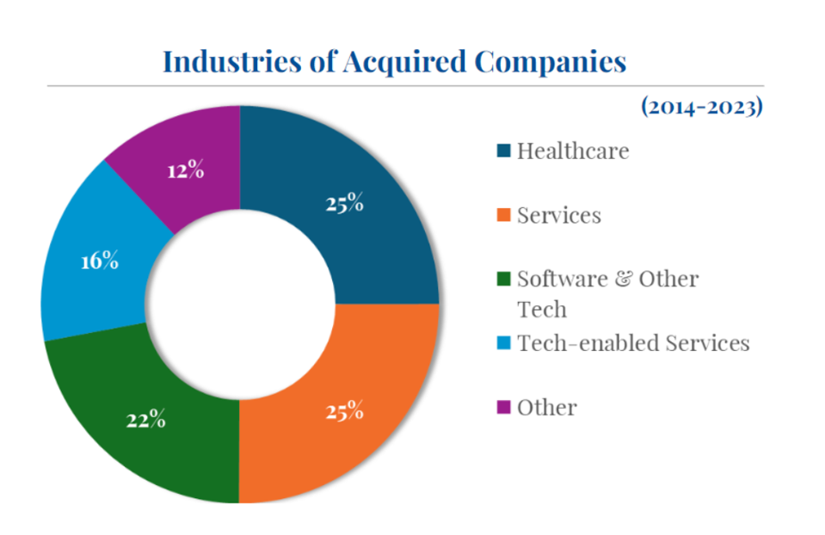
Who is Acquired?

Slide 12
GOOD TIME TO TAKE PLUNGE IN ETA
“Silver tsunanmi”: ~10,000 baby boomers, who make up over 40% of all U.S. small business owners, reach the age of retirement each day (and the pandemic accelerated their exit), and are selling their businesses (75M in total).
And a recent survey by Wilmington Trust suggests that nearly 60% of boomers do not have a succession plan.
Not all will sell, but economists expect we’ll see shifts in ownership for millions of profitable, well-established businesses, over the coming decades.
But, interest rates have jumped: current SBA loan rates ~10% (need to be thoughtful about liquidity management)

Slide 13
IS ETA A GOOD FIT FOR YOU?
“KNOW THYSELF”
Successful entrepreneurs share: Attitude (growth mindset); Aptitude (when have you been successful in the past?); and Action
What’s your tolerance for risk? Are you afraid of failure?
How do you feel about debt?
Are you a natural CEO or more effective as a deputy or passive investor?
Are you an effective manager of people?
How concerned are you with prestige?
How do you feel about “going it alone”?
I’m convinced that ETA mostly about conviction-building and internalizing a commitment to execute, learn the business, persist and ultimately scale and experience success.
13

Slide 14
Insights from 2024 Stanford Search Fund Study

Slide 15
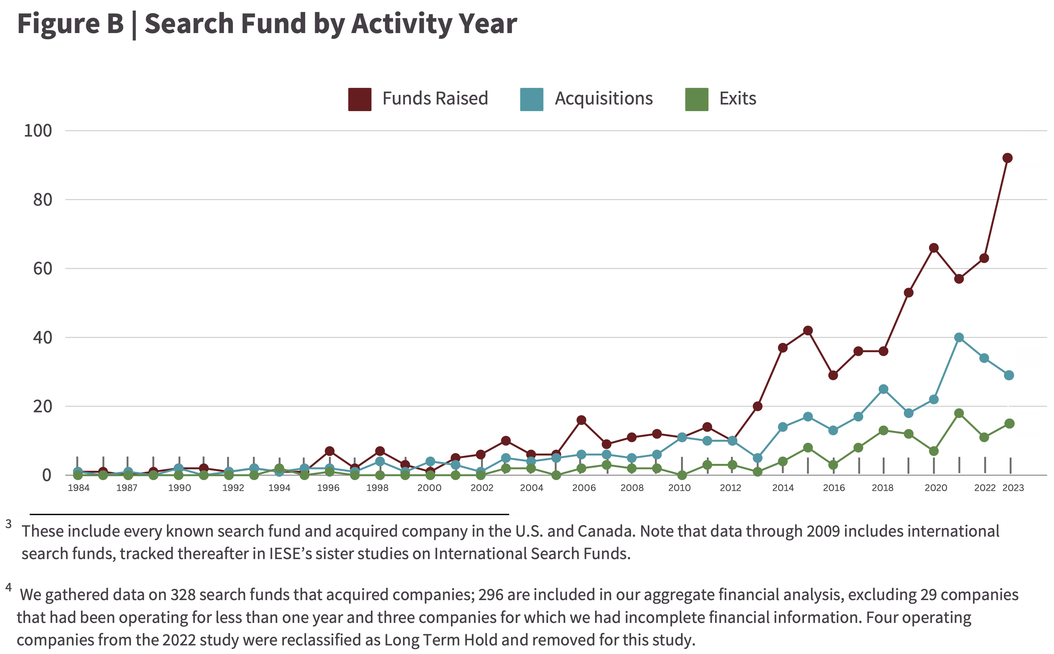
Search Fund Activity

Slide 16
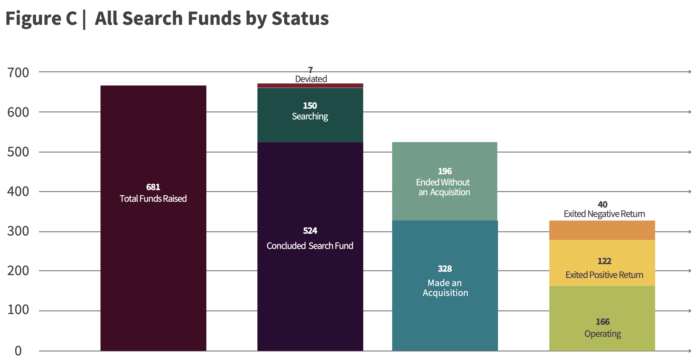
Search Fund Status

Slide 17
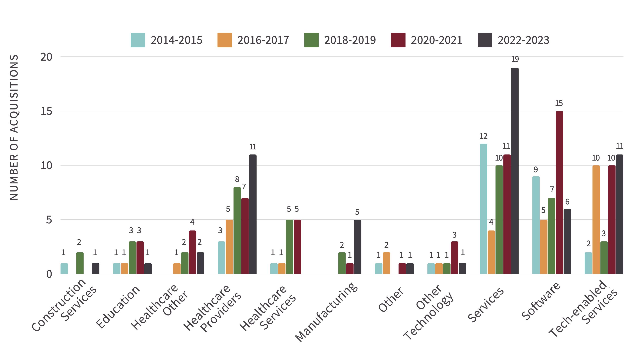
Industry of Acquired Companies, by Year

Slide 18
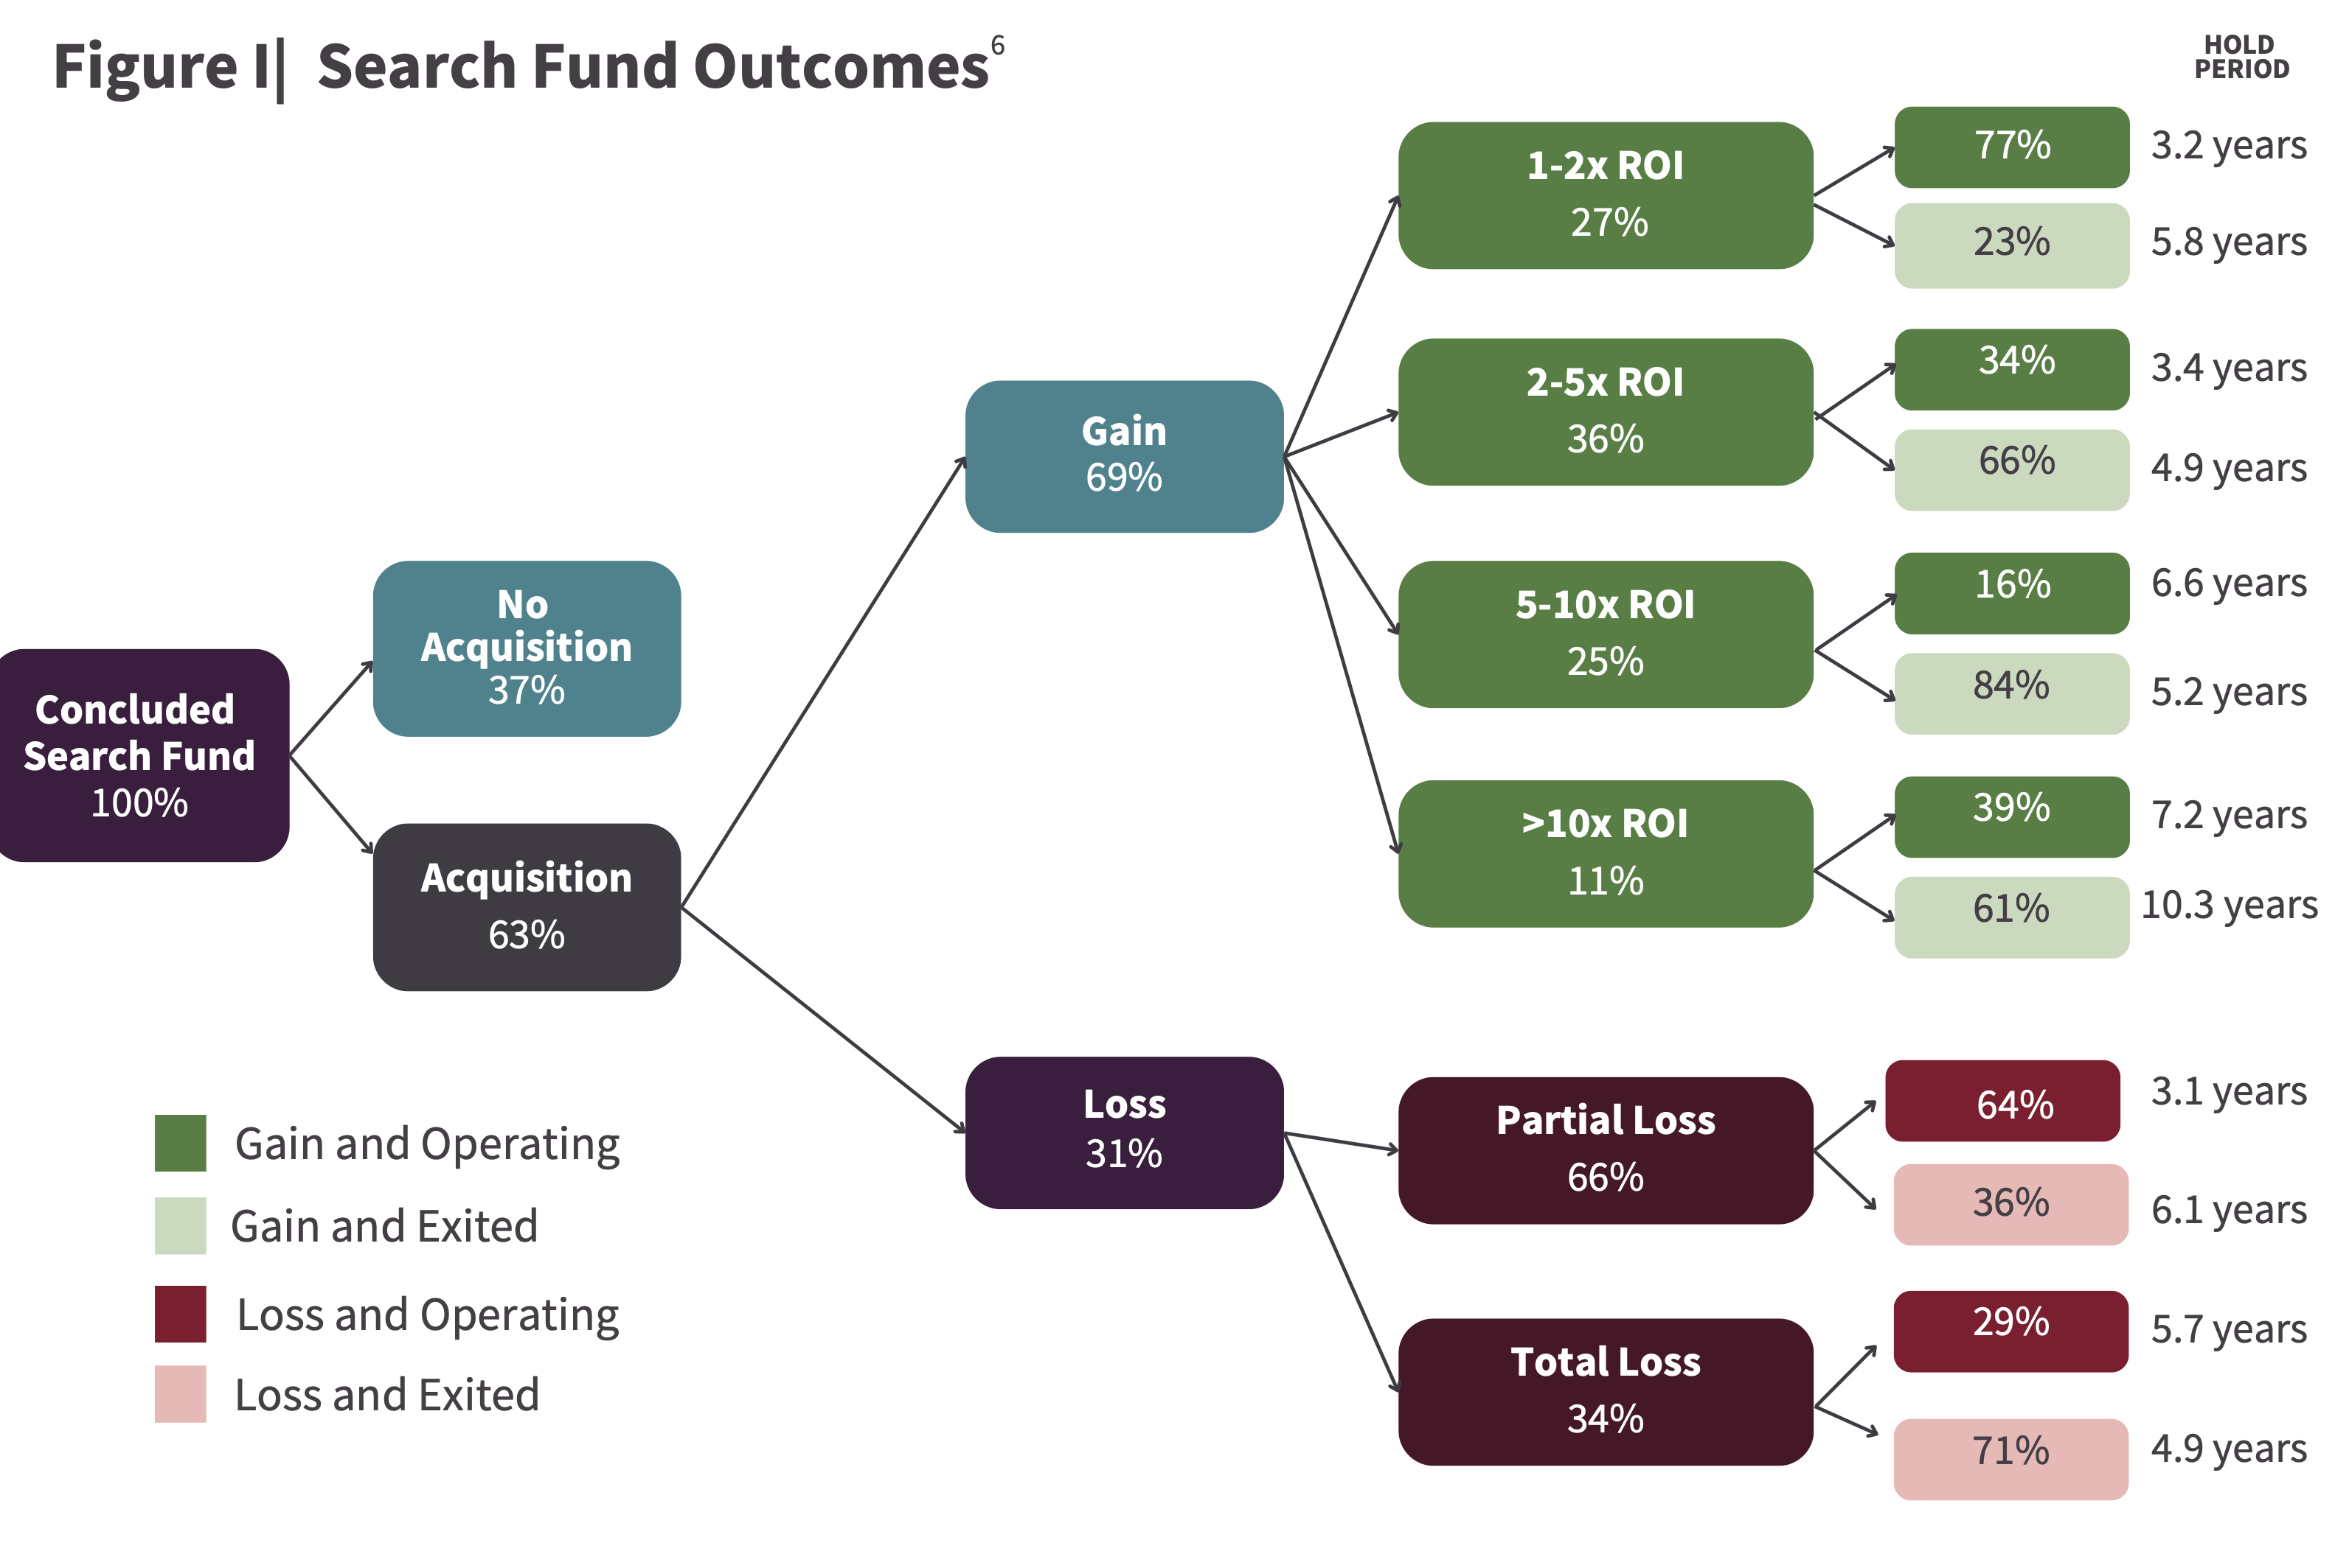
Search Fund Outcomes

Slide 19
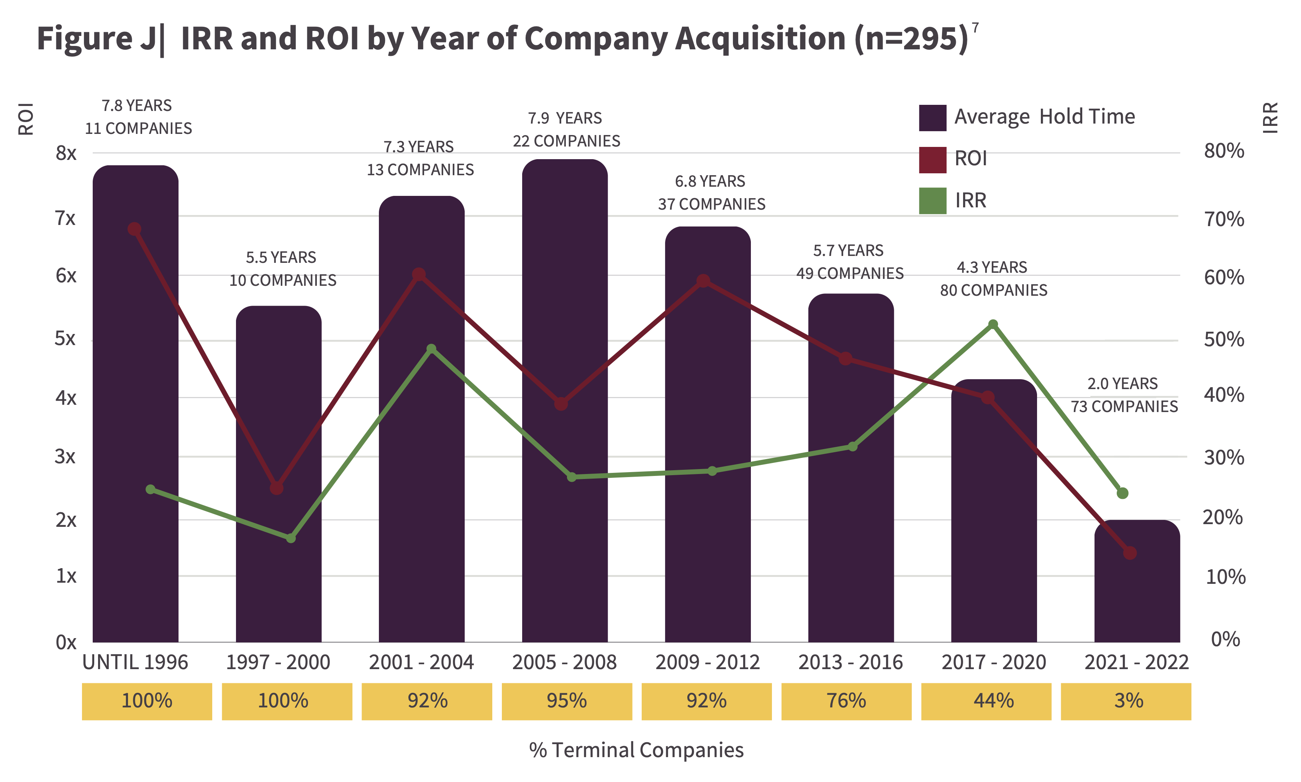
Acquired Company Outcomes

Slide 20
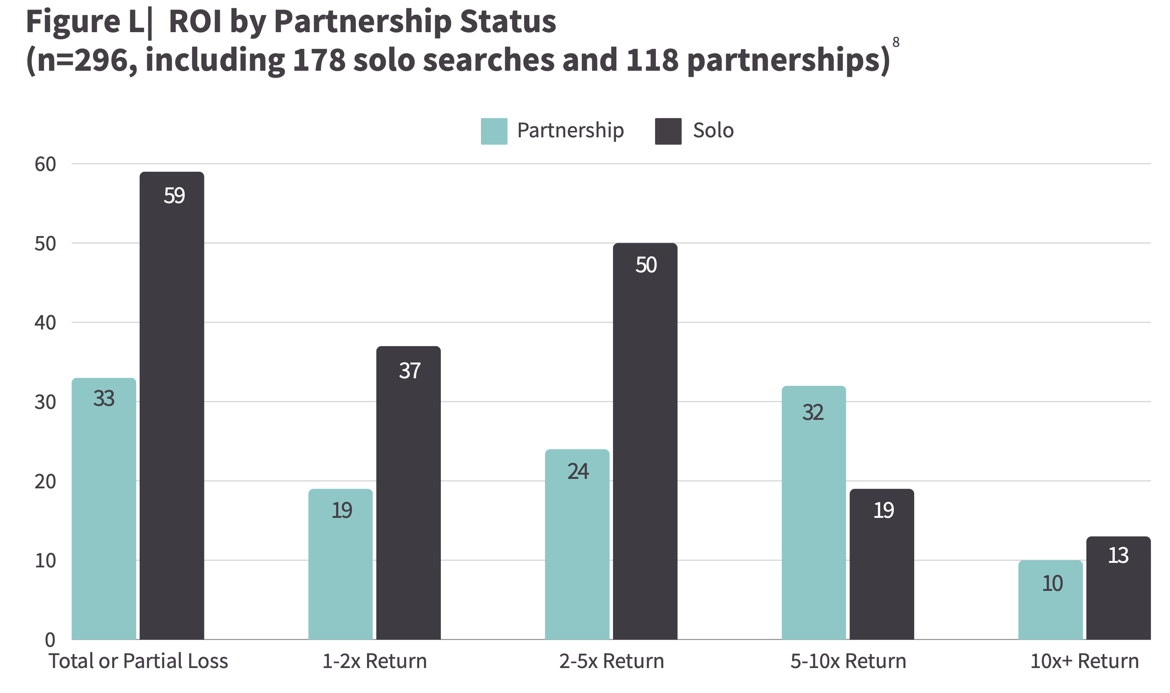
ROI by Solo vs Partnership Acquisitions

Slide 21
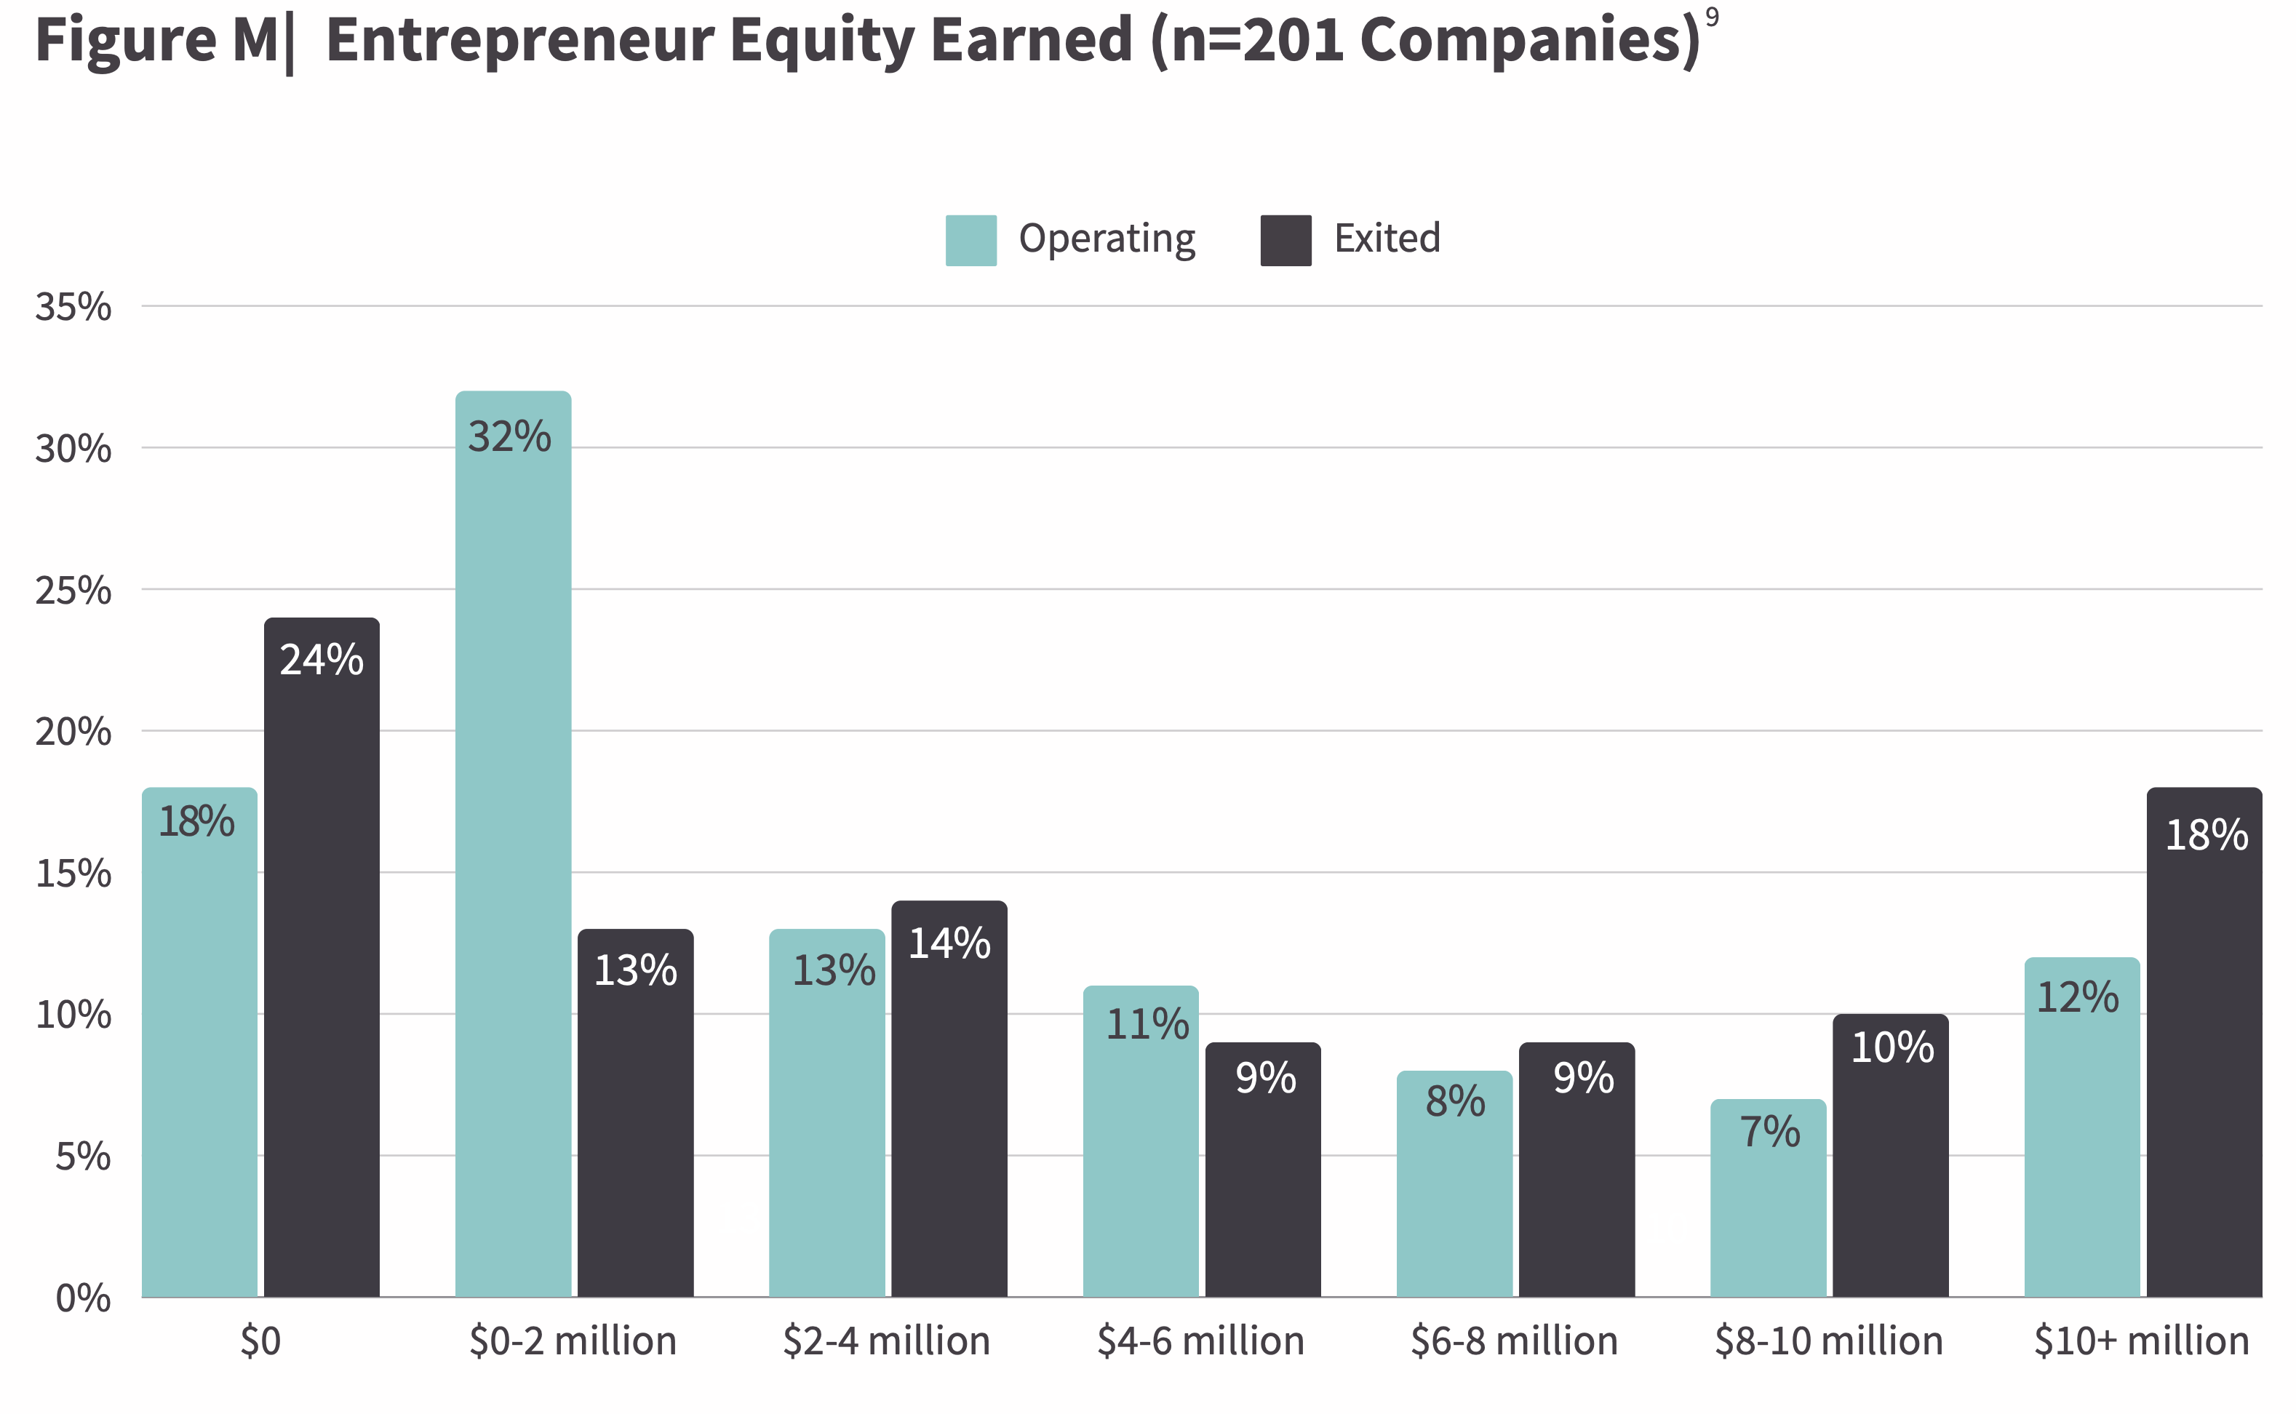
Entrepreneur Equity

Slide 22
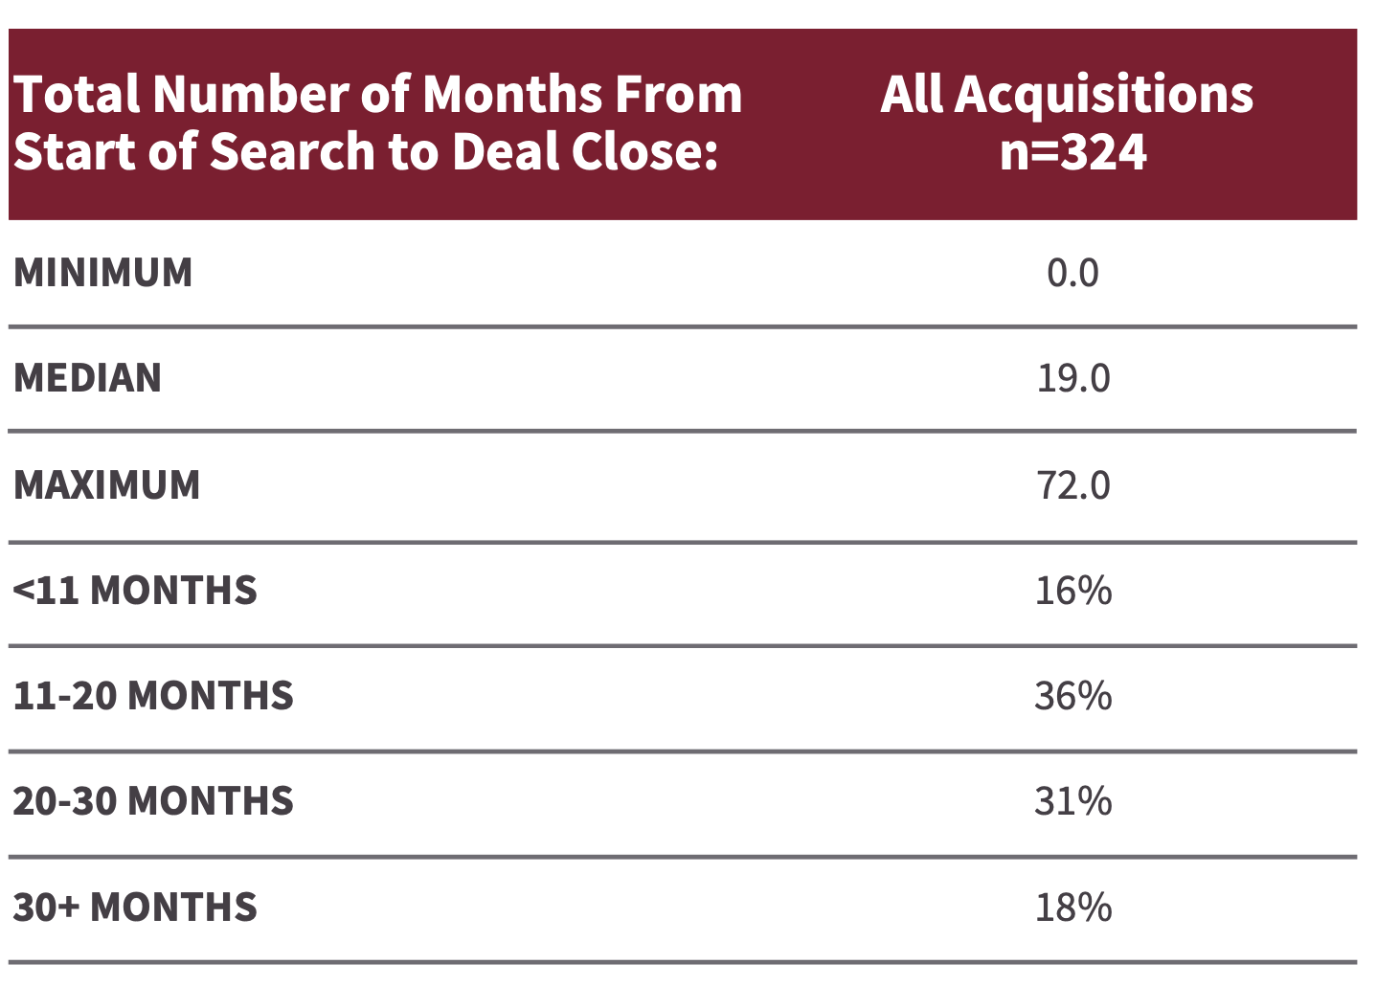
Time Until Acquisition

Slide 23
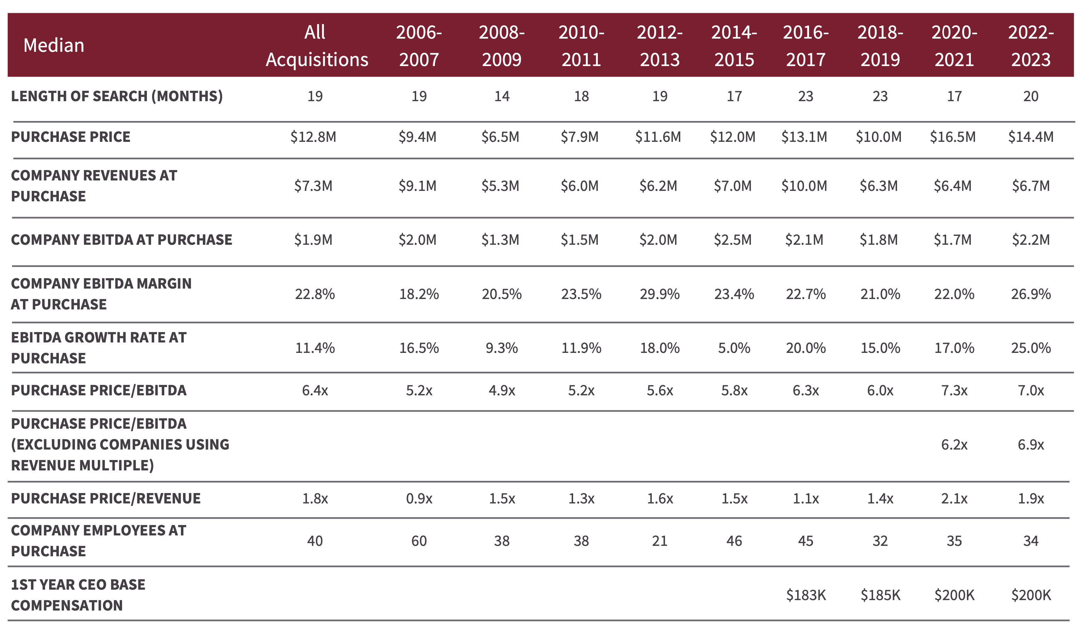
Acquisition Statistics

Slide 24
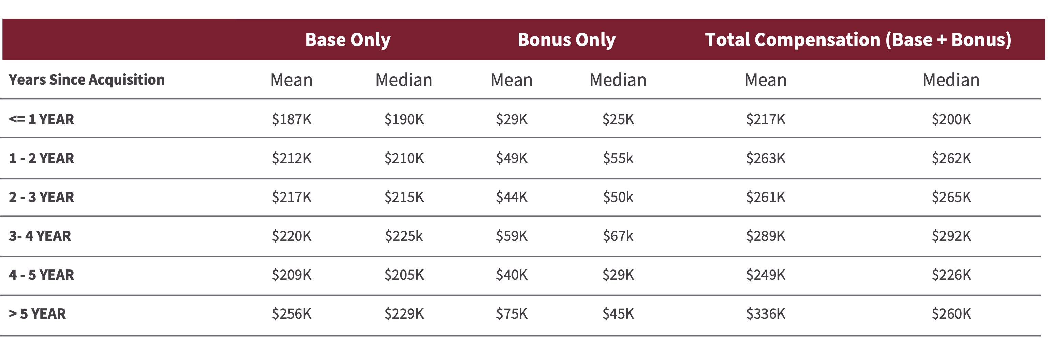
CEO (Searcher) Compensation

Slide 25
OLIN’S ETA COURSE
Identify acquisition targets and contact the target company
Submit a non-binding term sheet
Due diligence of a target company
Structuring your acquisition
Valuation
Funding sources
Closing process
How to grow the business you buy and ultimately monetize

